Slide 1



MD&I Accenture Experience
Country Selector
Going Digital

Slide 2
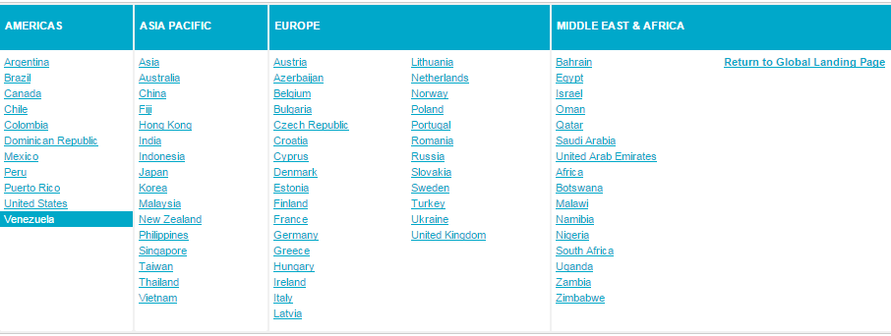
Accenture Experience Country Selector
Country Selector
Copyright © 2014 Accenture All rights reserved.

Slide 3







Life cycle of a Module
Requirement
Design
Blueprint of the module.
Planning of creative deliverables.
Initial stage of development.
On the basis of the requirement the ideas are brought into picture by various brainstorming sessions.
Requirement
Brain storming
Idea
Develop & Validate
Product Templates & Page rendering script
Development through coding with Java, JSP, jQuery, CSS
Custom Functionality
Deploy

Slide 4
Delivery
Solution

Slide 5
Functionality : Country Selector
Back
Copyright © 2014 Accenture All rights reserved.

Slide 6
Leveraging of Module by Solution Architect
On the basis of the requirement, identify the modules which can be leveraged from MD&I
Analyze the Module
Module Details
CQ Version
Efforts
Calculate Effort Saving
Click to see Estimation
Drive the Solution
Provide Feedback
Back

Slide 7
Solution
Requirement of a module.
Check existing Repository.
Identify the Module.
Calculate Effort saving.
Feedback to MD&I
Plugin Estimation.

Slide 8
Module : Overview Country Selector
Functionality
Read Me
Code
Test Script
Questions?
Copyright © 2014 Accenture All rights reserved.
Back

Slide 9
Module : Overview
Module - A way through Author can manage content on a web page so easily.
Independent, reusable pieces of content rendering logic.
Collections of content rendering scripts.
Country Selector
It lets the user select a particular country.
After selecting the country the user is displayed with the contents of the selected country.
Back
Copyright © 2014 Accenture All rights reserved.

Slide 10
Read Me
Compatibility
1. CQ5.6.0 and above.
2. JDK 1.6 and above.
How to Integrate
With a kit, one will get a package.
Upload the package in package manager console of your CQ and install.
Upload the bundles on console.
Upload the bundles. Click to Activate.
How to use a module
1. Log on to the Author instance of AEM6.
2. Go to the siteadmin page, i.e. http://localhost:4502/siteadmin#/content
3. Click Design in Sidekick and then click on “edit” beside Design of tabpar.
4. Select Country Selector Component and click ok.
…
How To Deploy
Log on to the Author instance of CQ 5.6.1.
Go to the site admin page.
Drop module in the parsys.
Select a particular country in the country selector component.
Back
Copyright © 2014 Accenture All rights reserved.

Slide 11
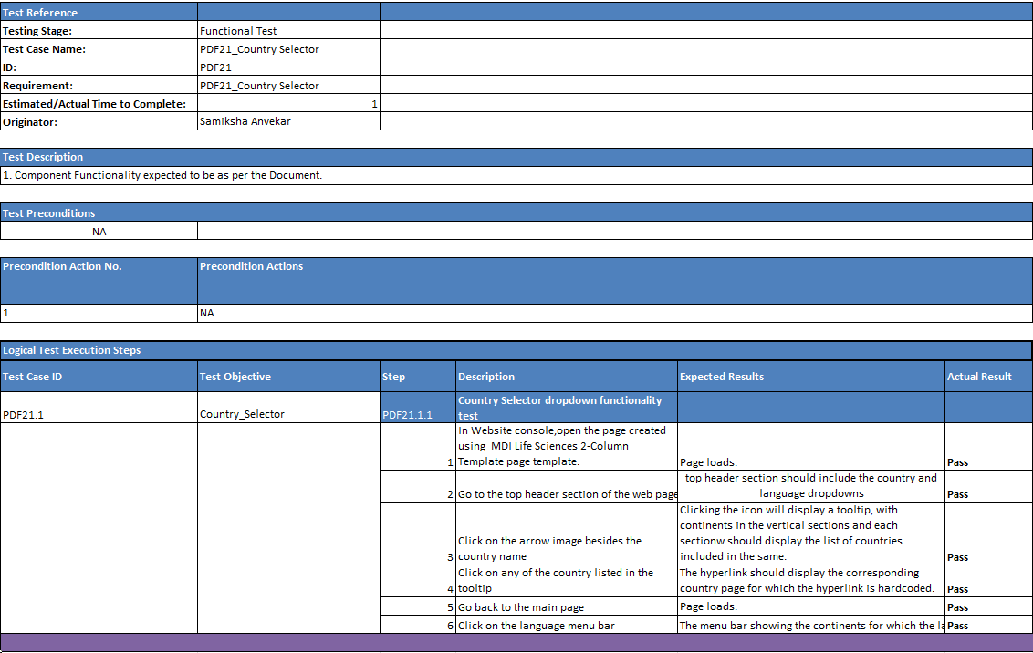
Test Script
Copyright © 2014 Accenture All rights reserved.
Back

Slide 12
?
Questions
Thank you
Back
Copyright © 2014 Accenture All rights reserved.

Slide 13
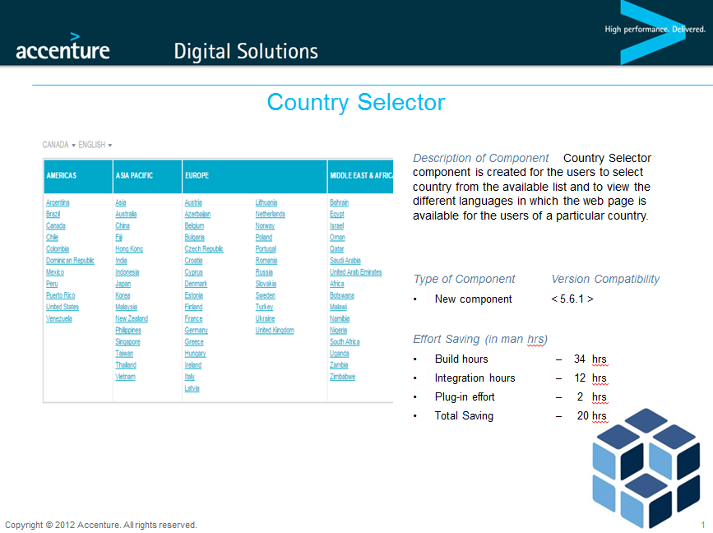
Copyright © 2014 Accenture All rights reserved.
Back

Slide 14
Link to the Code Repository
https://innersource.accenture.com/mdi_harvesting/mdi_harvested_components
Back

